Slide 1
Basic SolidWorks
By Friend

Slide 2
Pre-workshop
Download and install SolidWorks https://ubc.service-now.com/kb_view_customer.do?sysparm_article=KB0015800
Download Onshape and create an account using your student email
The CAD team may use different software such as Onshape, but use Solidworks for this workshop
The fundamentals are all the same

Slide 3
Agenda
Sketching, dimensioning, mirroring
Extrusion, adding text
Sheet metal

Slide 4
Final product from Basic SolidWorks and Adv. SolidWorks workshops

Slide 5
0. Setting up

Slide 6
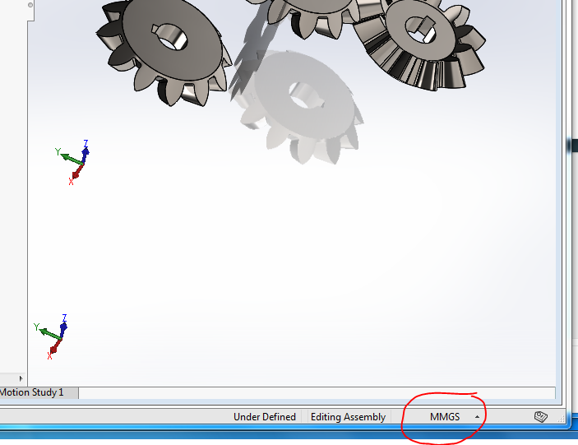
Units
Make sure you’re in MMGS for this tutorial!

Slide 7
Sketching, dimensioning, mirroring

Slide 8
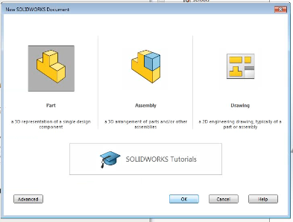
Create a new part
File -> New -> Part
This window should pop up

Slide 9

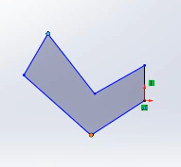
Sketching any shape
Select any plane, click “Sketch” at Sketch toolbar, and start sketching the rabbit.
Do not worry about dimensioning or relationships yet. Just make sure it looks similar to this.

Slide 10

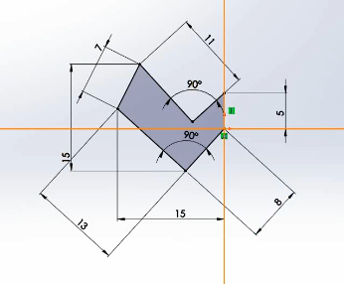
Adding dimensions
One by one, add the dimensions and relationship according to the image here.
As long as your original drawing somewhat resembles this, it will come together by itself once you start to add more dimensions.
Make sure you don’t have any extra dimensions or relationships, or you might not be able to add some of the required dimensions shown here.

Slide 11
Adding dimensions
Make sure all the lines are black when you’re done.
Black line means that drawing is fully defined. There’s no ambiguous part or any moving part.
Blue, under-defined.
Red or yellow, over-defined.

Slide 12
Dimensions

Slide 13

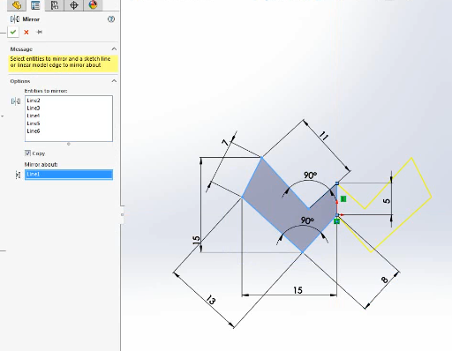
Mirroring
Select to “Mirror Entities”
Select all the lines except for the leftmost line to mirror, while choosing the leftmost line for everything to be mirrored about

Slide 14

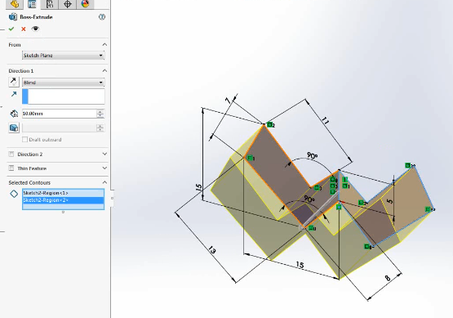
Extrusion
Click on “Extrude Boss/Base” at Features toolbar, and extrude by 10mm.

Slide 15
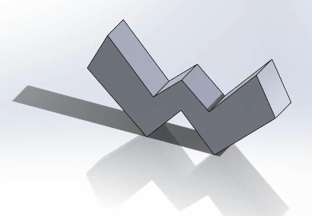
Done!
Save the file as “Item”(not that the file will be relevant later on).

Slide 16
2. Extrusion, adding text

Slide 17
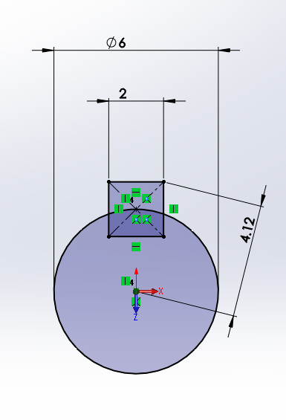
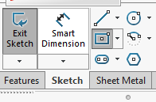
Sketching the base
On any plane, sketch this, then extrude by 10mm.
To draw the rectangle, it may be helpful to use center-point rectangle instead of the regular two-corner rectangle.

Slide 18
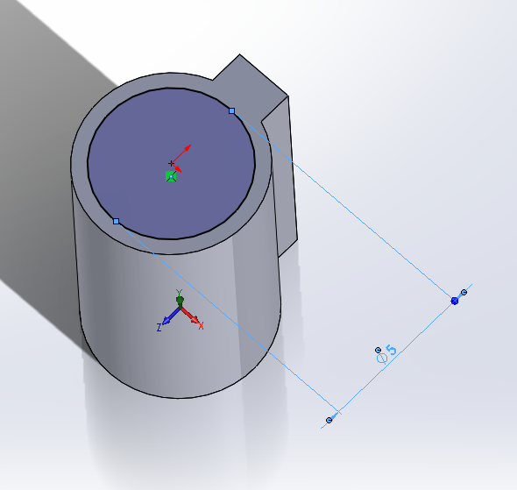
Extruding the arm
Draw a concentric circle on the extrusion, then extrude by 10mm.

Slide 19
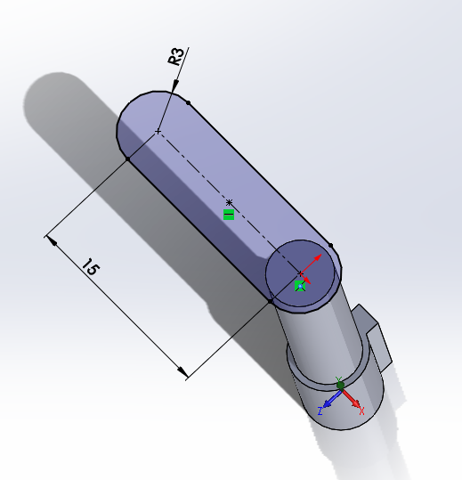
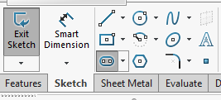
Extruding the arm
Draw a slot to make the arm, then extrude by 5mm.
To draw the slot, it may be helpful to use “Straight slot” in Sketch toolbar.

Slide 20
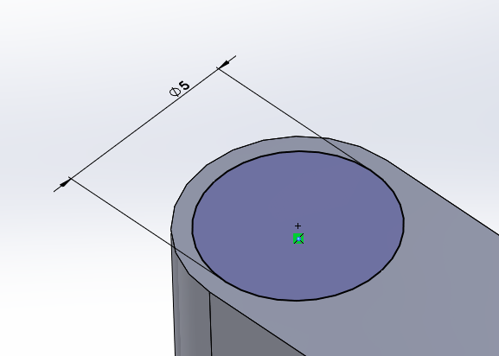
Extruding the arm
Draw a concentric circle on the arm, then extrude by 10mm.

Slide 21
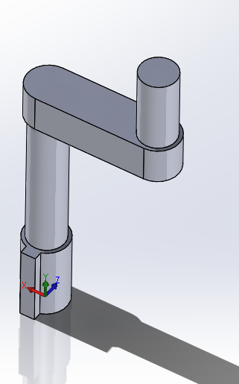
Extruding the arm
You should have this form at this point.

Slide 22
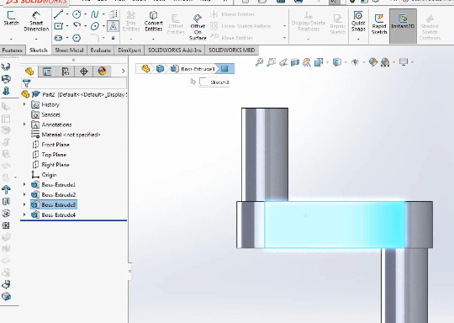
Adding text
Select a side face of the arm.
Go to Sketch toolbar and click “Sketch”. Click “Text” to add text.

Slide 23
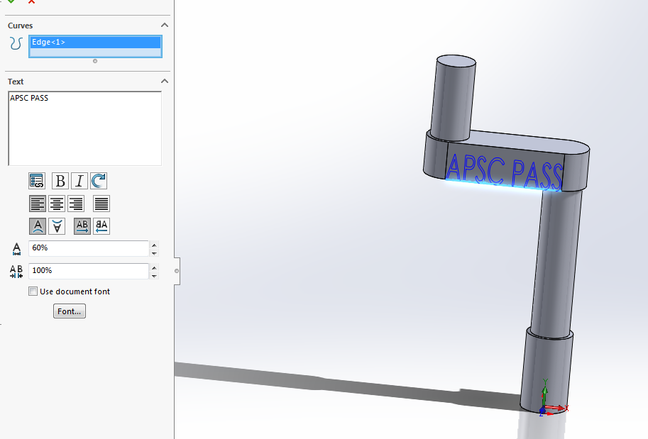
Adding text
Choose any text(I’ll go for “APSC PASS”).
Default setting for the text is the document’s. Untick the option so you can modify text to squeeze it into the given space.
Extrude 2mm cut.

Slide 24
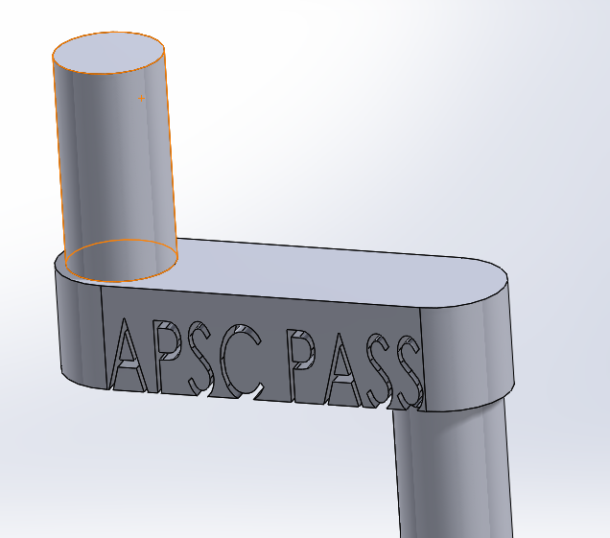
Done!
Save the file as “Handle”

Slide 25
3. Sheet metal

Slide 26
Adding sheet metal to Toolbar
Two ways:
Right click on Toolbar and a options will appear. Tick on “Sheet Metal”
View -> Toolbars -> Sheet Metal

Slide 27
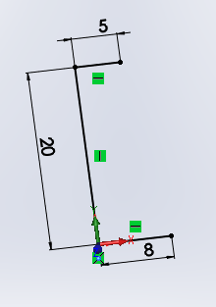
Sketching
Select any plane and sketch accordingly.

Slide 28

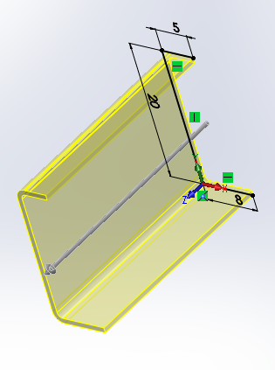
Sheet metal
Go to Sheet metal toolbar, click “Base Flange/Tab”.
Extrude by 30mm.

Slide 29
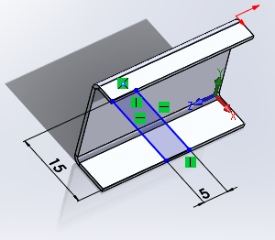
Sheet metal
Select the top face of the claw, and sketch accordingly.
Go to Sheet metal toolbar, click “Base Flange/Tab” to add the tab to the claw.

Slide 30
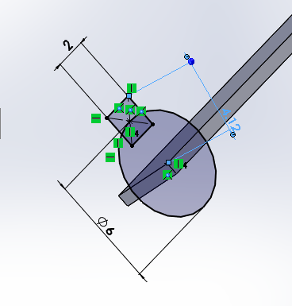
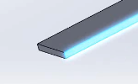
Sheet metal
One the inner side of the tab, sketch accordingly.
Extrude by 10mm.

Slide 31
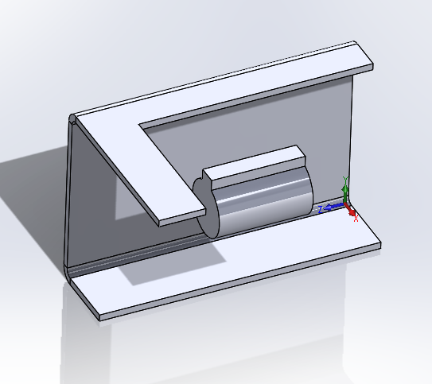
Done!
Save the file as “Claw”

Slide 32
Some further readings
Get certified with CSWA https://www.solidworks.com/sw/support/cswa-academic.htm talk to Rapid’s External Coordinator for this
There’s a good cert. prep. course on Lynda (free with VPL account)

